Slide 1

Ecommerce Website (M.r. E-commerce)
Group 41:
1)Aniket Sharma
2) Soumya Singh
3) Isha Gaonkar

Slide 2
Problem Definition
The concept of e commerce website is very common
and is very difficult to maintain the secrecy and the
Broadness of the things that can be sold on the websites .
The concept’s of e commerce also tends to get old as new technology are been introduced and are need to be implemented for the betterment of the user and making it more interesting.

Slide 3
Review of Literature
SR.NO | TITLE | AUTHORS | DESCRIPTION
1. | Consumers’ Trust in Electronic Commerce Transactions: The Role of Perceived Privacy and Perceived Security | Ramnath K. Chellappa | The paper written by Ramnath K. Chellappa is the analysis of the people more certainly the buyers on the e commerce website. The research is done with the help of different hypothesis. These hypothesis were tested and studies where done on the results obtained. In total of 3 studies done with respective to the hypothesis and to verify the convergent, discriminant and factorial validity of our study involving a sum total of 217 subjects. Different set of data were obtained and were used to analyse the process. At the end the conclusion was that the consumer requires a significant amount of trust to be assure of the transactions made by him / her. That trust is required in both offline and online commerce. This trust in the field of e commerce can be obtained by providing more transparency about the working and what kind of data is been taken by the website at the end of an transaction and how safe are they.
2 | Future of E-commerce in India |  | This paper reviews the literature on the basis of secondary data collected from various references which already exist in published from such as articles, books, newspaper, national/ international journal, magazine, annual reports, government and non-government publication and company official websites, etc. This paper reviews the literature on the basis of secondary data collected from various references which already exist in published from such as articles, books, newspaper, national/ international journal, magazine, annual reports, government and non-government publication and company official websites, etc. This paper is basically the study about how the e commerce has grown over the years in India. The paper also has a mentioning about how covid 19 and the lockdown restrictions in India has effected the e commerce and online shopping websites. The paper also has a good mentioning about the different trends and opportunities in India of E-commerce in India. A quote from paper ‘Innovation and individuals are continually developing, and since e-commerce unites everything, we are continually going to be looking toward what's to come’. In conclusion the paper states that as the internet increases the industries of the e commerce grows with it.

Slide 4
Review of Literature
SR.NO | TITLE | AUTHORS | DESCRIPTION
3. | A Survey of Blockchain Security Issues and Challenges | Iuon-Chang Lin1,2 and Tzu-Chun Liao2 | The paper written by authors Iuon-Chang Lin and Tzu-Chun Liao justifies why the blockchain is the hot topic in recent times and have great interest of the new generation. The paper gives and proper understanding of how the blockchain works. It also has a segment where the user can easily understand how the blockchain is created and how the hash value have such importance in blockchain development. The also tells about the pros and cons of blokchain development . the author at the end is in the favour of the blockchain development as the pros have outdone the cons.

Slide 5
Introduction
There are many e commerce website which can have certain rules and restrictions about you can sell and buy and how you can go about it.
Our websites is been made to cover a broader spectrum of things that can be sold on or website
One of the main features of our website is the blockchain dependent transactions security
Blockchain helps the decentralized the transactions and makes it more trustworthy for the seller and the buyer

Slide 6
Background
There are many website which have certain privacy and data corruption possibility .
The user has basically now idea what is happening with his/her data
This eventually leads to loss of trust of the user in ever aspect of the internet

Slide 7
Proposed Solution
A website with a decentralized system of transaction management which will leads to gaining more trust of the user in the website and attracting more business towards the company
Blockchain is the technology which has the developer in crypto market to achieve decentralization and eventually more trust towards It as the new generation comes along
A broader spectrum of things that can be sold (ie projects, digital assets) and a much broader spectrum of transaction currency (ie crypto currency and many more )

Slide 8
FEATURES
The E commerce website is just a implementation tool to show how the blockchain can be an game changer in. the e commerce industries
The website is highly user friendly as the user can use the feature like speech to txt and etc

Slide 9
Login page
Login page us an developers to add a firewall between the unknown users and our websites interfaces
Login page in our website is made with the help flask framework and MY sql database and the authorization is done with the help of python

Slide 10
Home page
the user will have different products such different project with source code and many more different products similar to that available for sale
The website is made user friendly using the recommendation interface which will allow the user to have options to related searches

Slide 11
Dashboard
Dashboard will have all the user details along with the transaction History table
The transaction history table will have all the user pervious records
The transaction table will also have the data product id and datetime of the transaction
Which will show the that their data has been successfully been stored in to the
blockchain

Slide 12
Transactions
The transactions are decentralized by using blockchain technology
The transactions can be done using different methods like currency(That currency could be anything, currencies of respective countries/cryptocurrencies etc.)(ACE coins)

Slide 13
FLOWCHART OF WEBSITE
Dashboard (Transaction History)
NEW USER/LOGIN
HOME PAGE
(Product Recommendation)
Sending email to user for the password
Adding Transaction Details
Product details
(Pricing and ratings)
Authorizing the payment from ace coins wallet
BUY NOW
Downloading the details using the password received one mail
Thanks For Buying from Mr.E-commerce

Slide 14
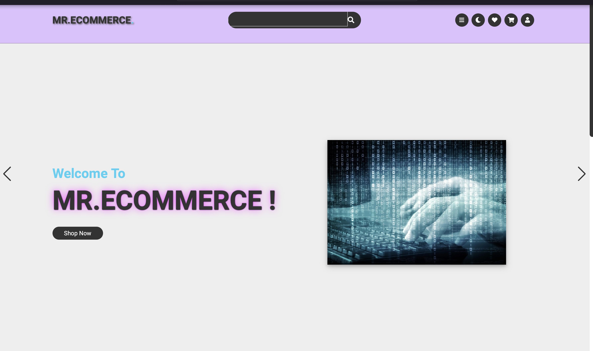
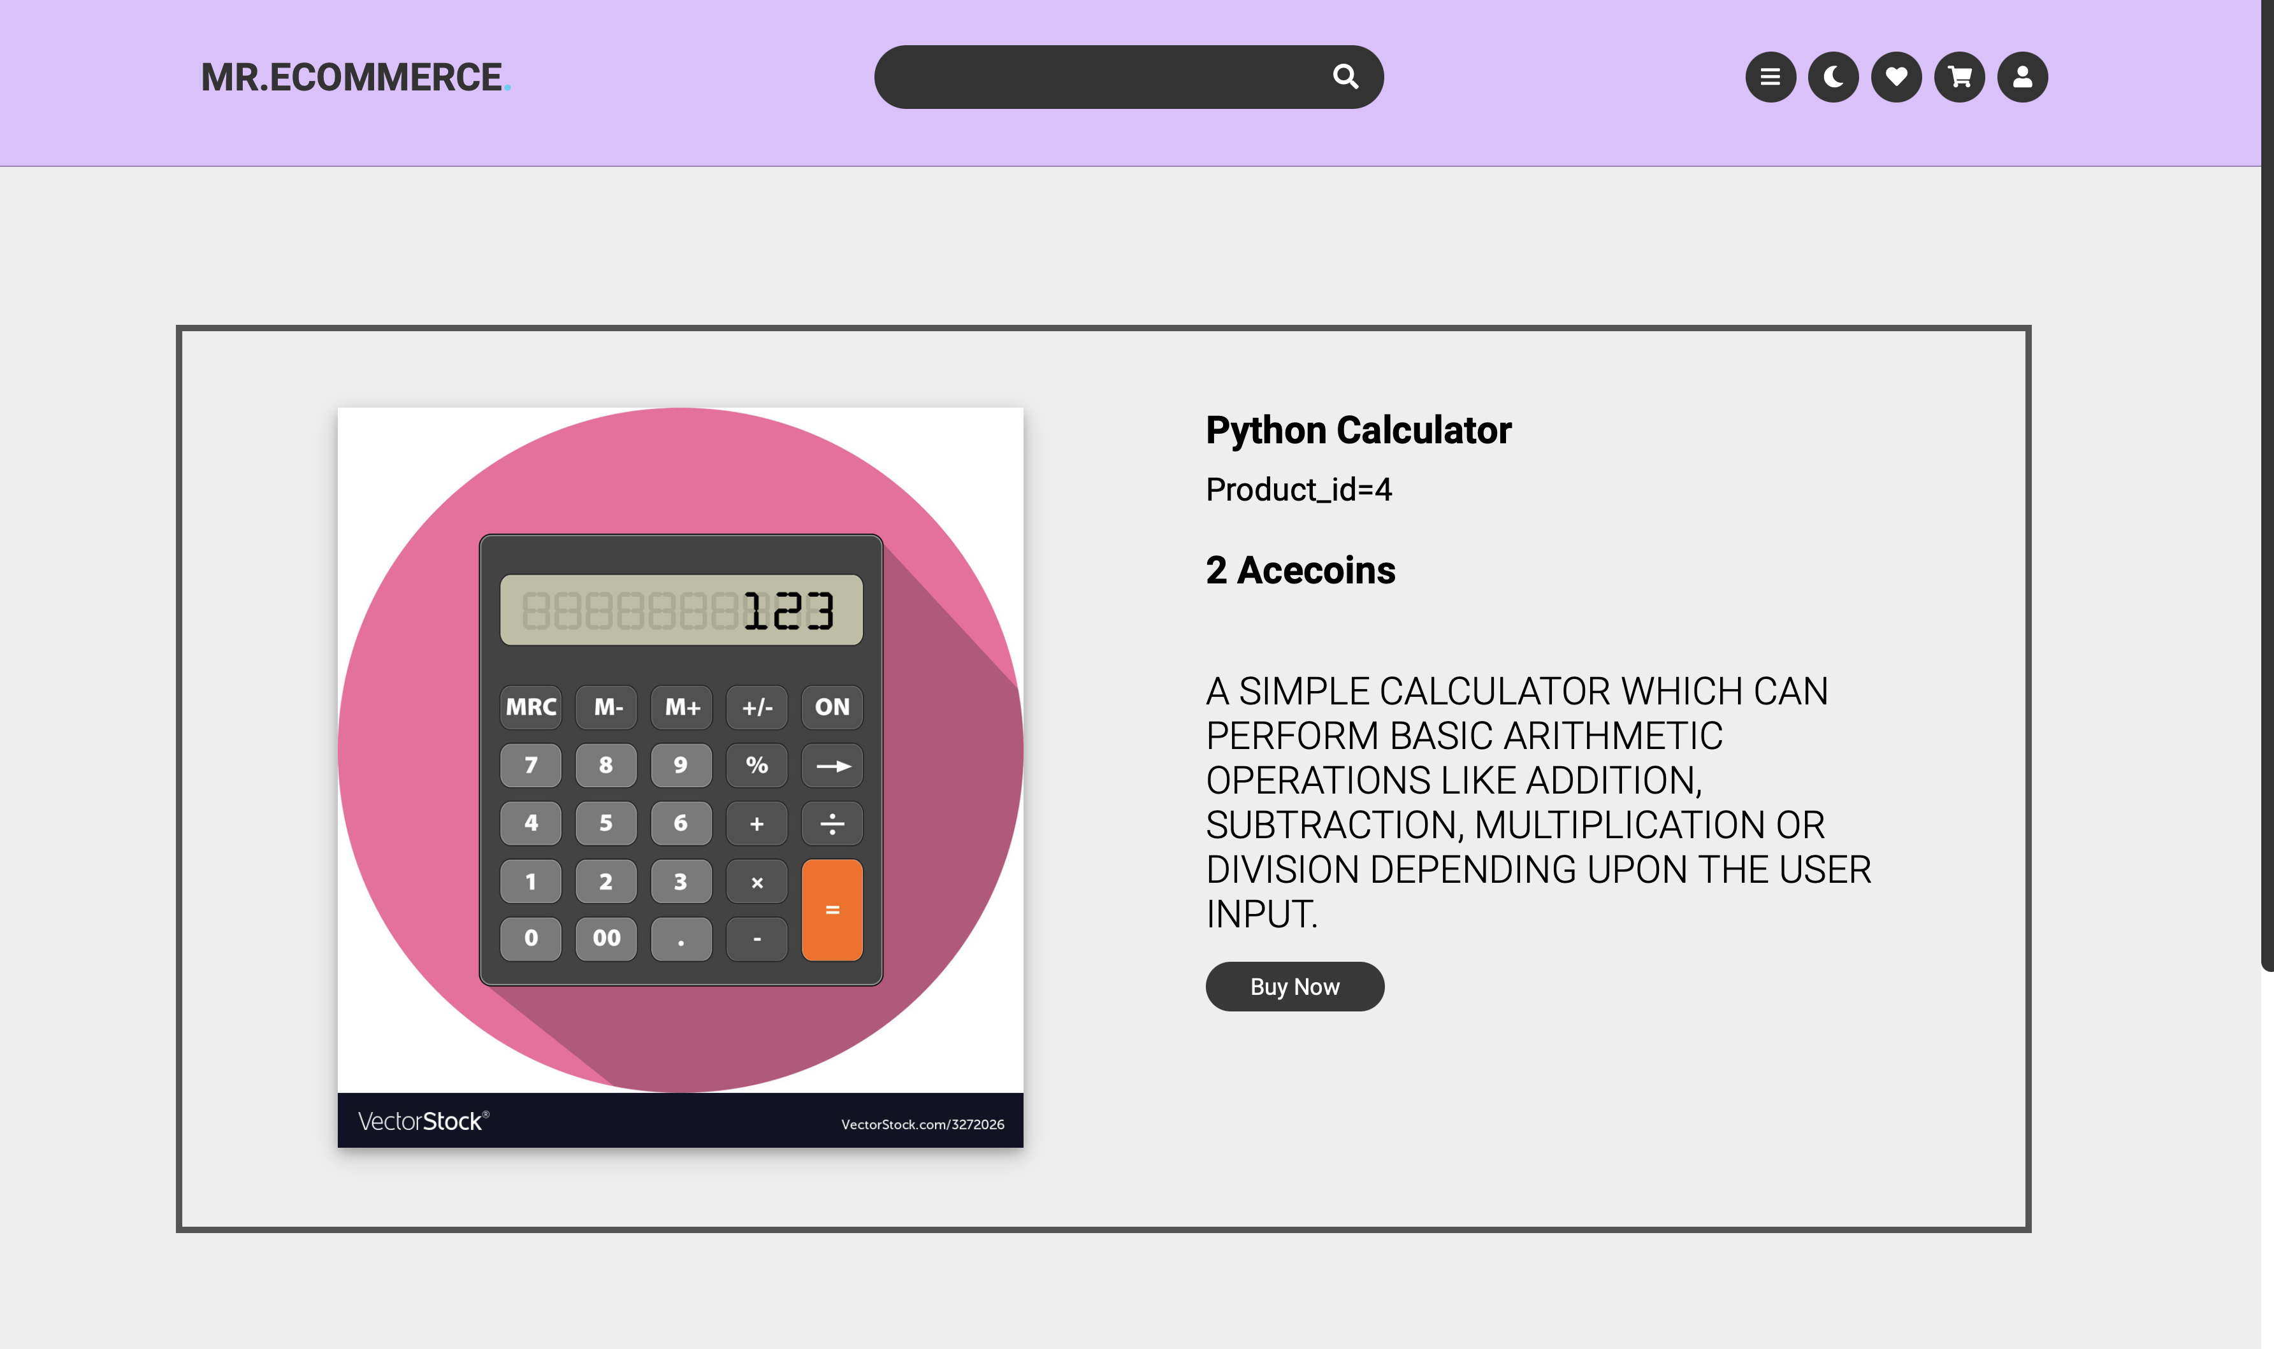
Screenshot of the implementation

Slide 15
THANK YOU

